Slide 1
Getting benefits of OWASP ASVS at initial phases
NDS {OSLO} 2018
Oleksandr kazymyrov
EVRY PUBLIC

Slide 2
Introduction

Slide 3
Introduction
Security Development Lifecycle (SDL)
What is a secure application?
S.M.A.R.T. criteria

Slide 4
Specific
Is it clearly described and understandable?
Measurable
How will you know when you are reached it?
Achievable
Are you able to accomplish it?
Relevant
Time Limited
Is the web application criterion in line with business needs?
When do you want to achieve it?

Slide 5
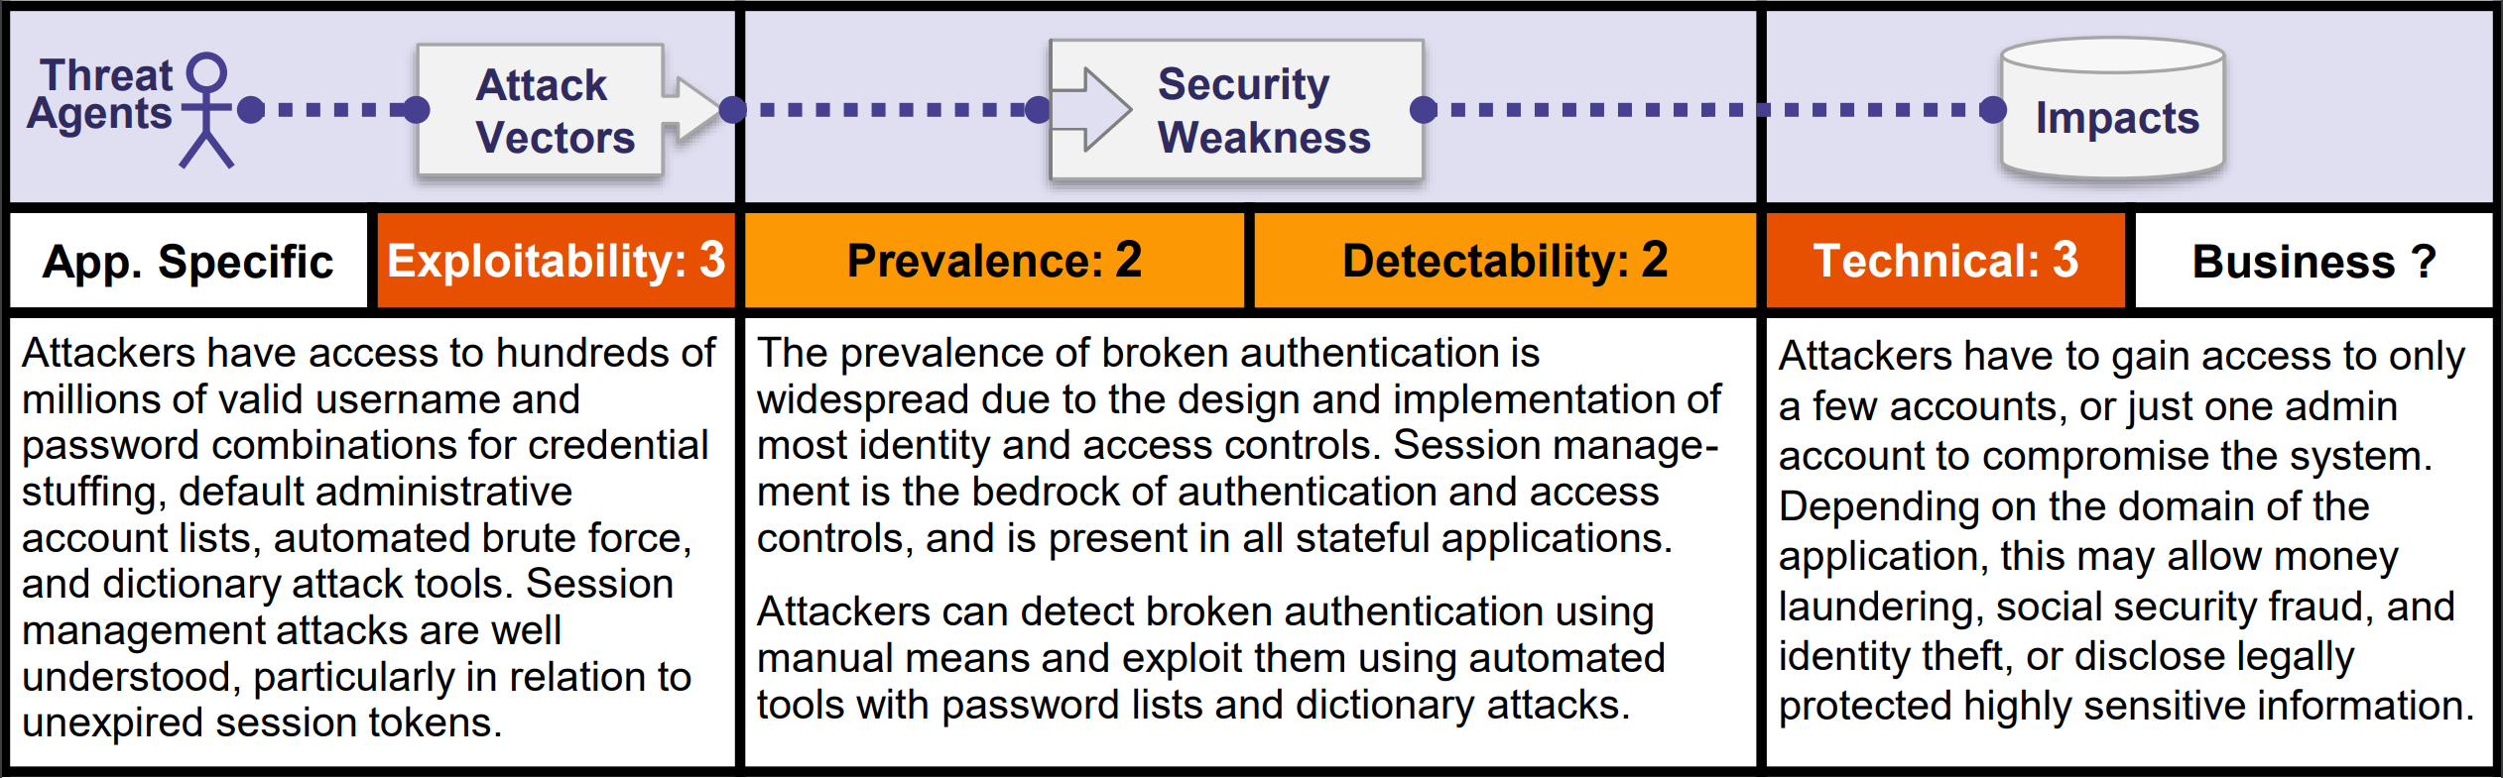
Achievability
OWASP Top 10 2017 – A2 Broken Authentication

Slide 6
Achievability and Pareto principle
Result
20% EFFORT
Effort
80 %
RESULTS

Slide 7
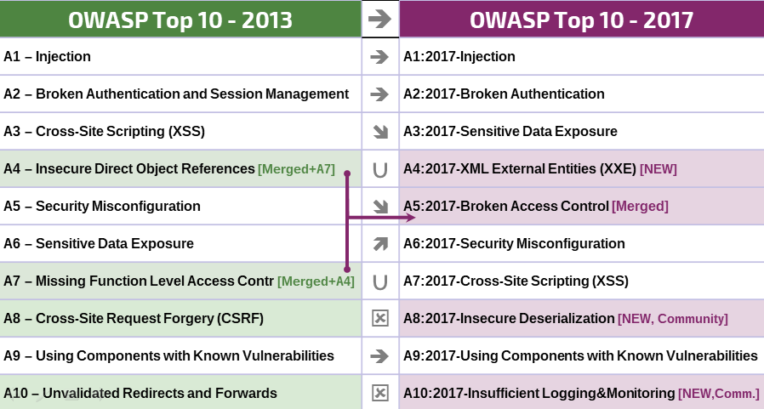
What changed from 2013 to 2017?
Deserialization vulnerability

Slide 8
OWASP Top 10 2017 through the S.M.A.R.T. prism
No: general
Specific
Measurable
Achievable
Relevant
Time Limited
High level: yes
Low level: somewhat
OWASP Top 10 2017
Somewhat
N/A / Yes
N/A / Yes

Slide 9
OWASP Top 10 2017
“The OWASP Top 10 is a powerful awareness document for web application security. It represents a broad consensus about the most critical security risks to web applications.”
“The OWASP Top 10 is a powerful awareness document for web application security. It represents a broad consensus about the most critical security risks to web applications.”
about the most critical security risks
https://www.owasp.org/index.php/Category:OWASP_Top_Ten_Project

Slide 10
OWASP Application Security Verification Standard (ASVS)

Slide 11
From PCI DSS to OWASP ASVS
PCI DSS
Penetration Test Guidance
OSSTMM
OWASP ASVS
...
NIST SP 800-115
OWASP Testing Guide
NIST SP-800-XXX
OWASP
SANS
…
PCI DSS mapping
MITRE CWE
OWASP Top 10
…

Slide 12
Scope for the application security verification standard
Description of security verification levels
Requirements / Controls
Standards Mappings
Key parts of OWAS ASVS (v3.0.1)

Slide 13

What is covered by OWAS ASVS?
Server Configuration
Mobile Clients
Web Services
Communication
Web Applications

Slide 14
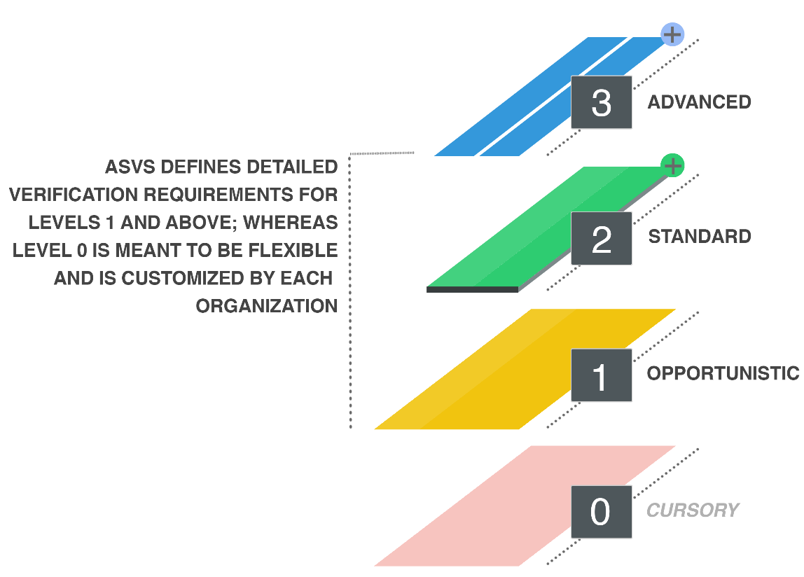
OWASP ASVS Levels
Opportunistic
Standard
Cursory
Advanced
Security
3
2
1
0

Slide 15
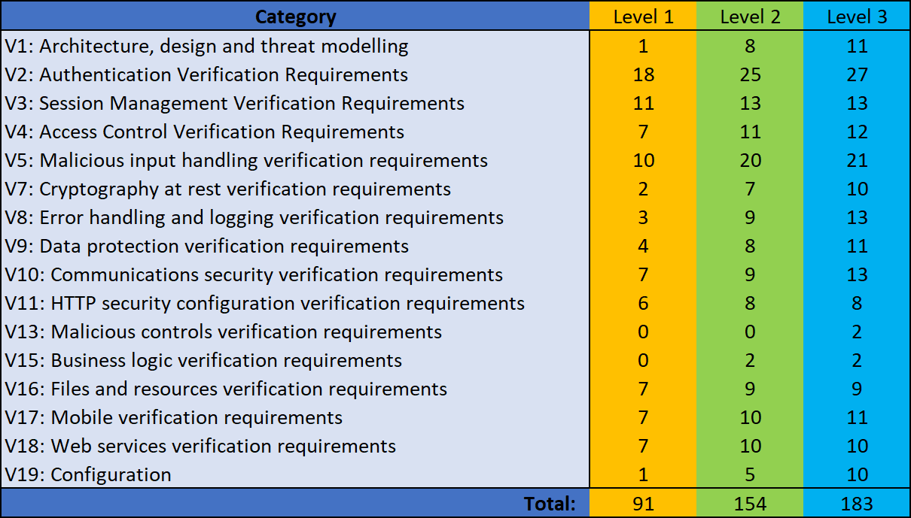
OWAS ASVS verification controls (v3.0.1)

Slide 16
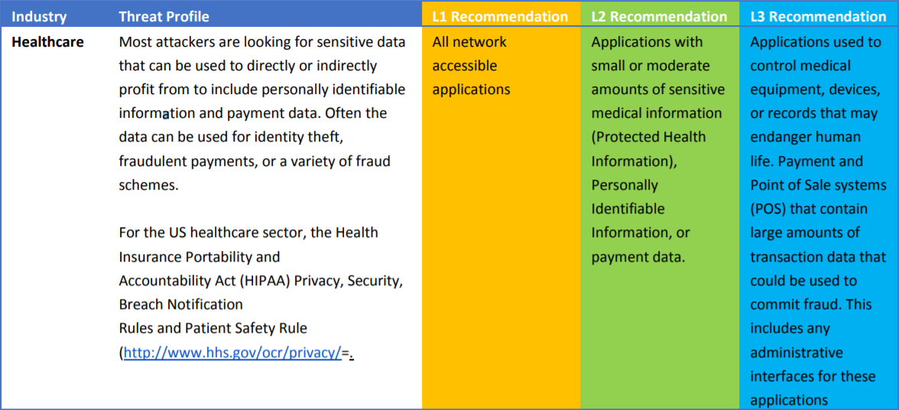
General level profiles

Slide 17
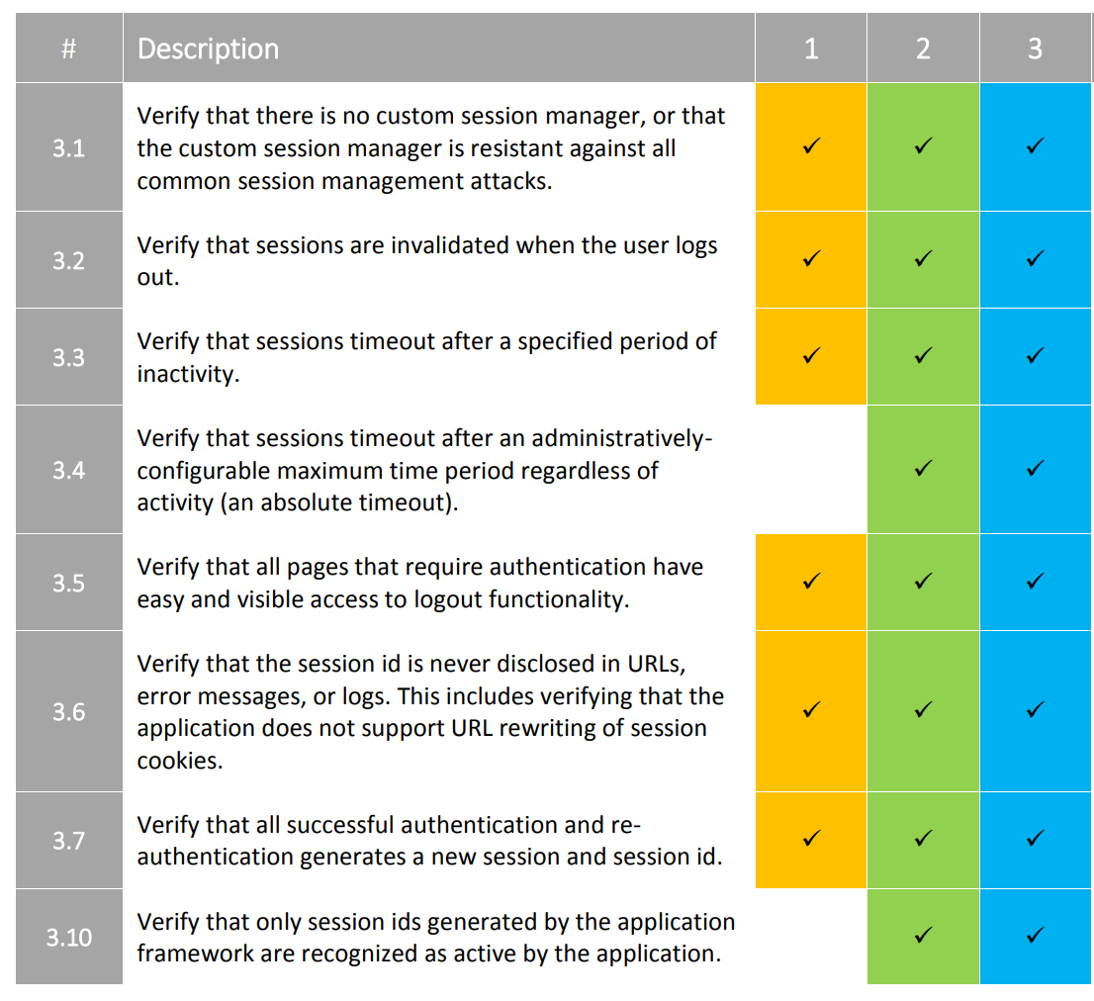
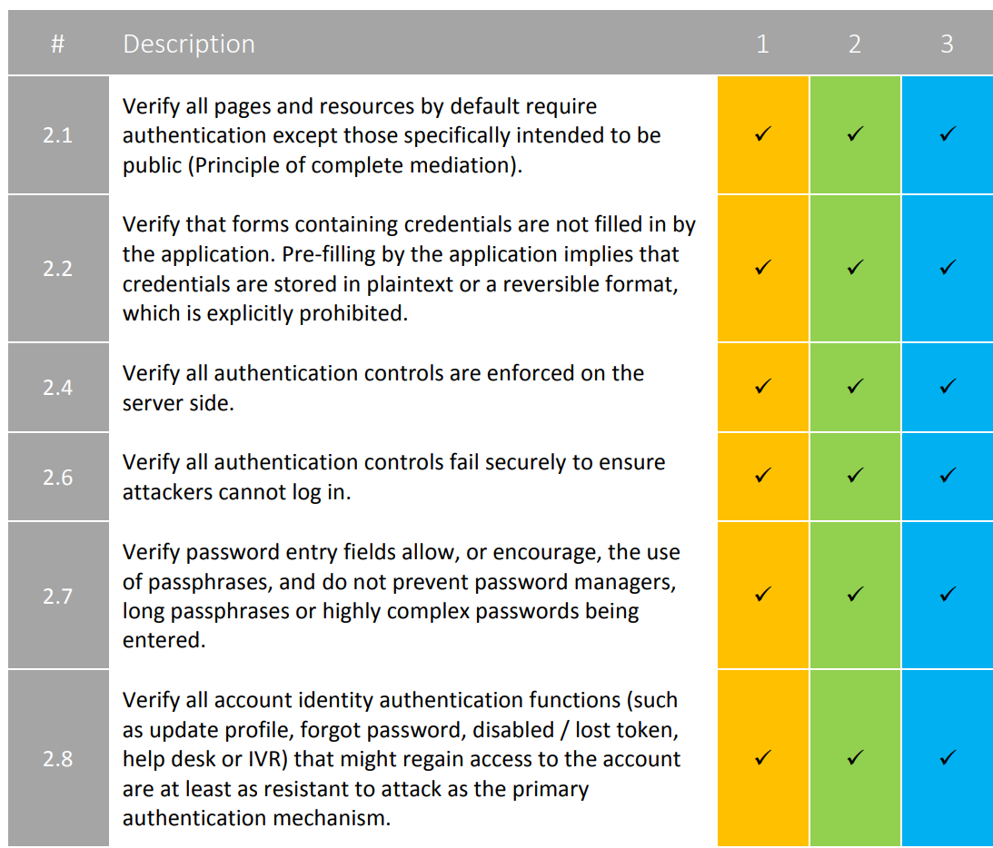
OWAS ASVS verification controls
V3: Session Management Verification Requirements
V2: Authentication Verification Requirements

Slide 18
OWASP ASVS
Architecture
Operation / Deployment
Development
Mobile & WS
OWASP ASVS
PCI DSS
OWASP Top 10

Slide 19
OWASP Top 10 2017 vs OWASP ASVS
 | Top 10 | ASVS
Coverage | Web applications* | Full stack
Perspective | Black box | White box
Measurable | Somewhat | Yes
Product size | Small / Medium | Medium / Large
Scalability | Flat | Flexible

Slide 20
Application of OWASP ASVS

Slide 21
Level definition for LS2 and CHC
LoginSevice2
Cardholder Client
LS2 stays in front of almost all applications
It is the first major security barrier
LS2 helps to retrieve tokens (i.e., Secure Object) and hand over it to the 3rd party applications
CHC is a part of EVRY’s NetBank (online banking)
It can be integrated with any 3rd party web application
EVRY’s NetBank is protected by LoginsService2 in front of CHC
After logging in CHC uses SO as the main parameter in session management
Available through the Internet
Available through the Internet
OWASP ASVS Level 3
OWASP ASVS Level 2 (3)

Slide 22
Compliance selection at EVRY Financial Services
FINODS | Highly Sensitive | Moderate Sensitive | Low Sensitive
SWW - Self Service Non-Portal Applications over Internet | L3 | L2 | L2
SSP - Self Service Portal Applications over Internet | L3 | L2 | L2
CSW - Non-Portal Applications over dedicated Office Channel | L3 | L2 | L1
CSP - Portal Applications over dedicated Office Channel | L3 | L2 | L1
ESI - Web Services Applications over Internet | L3 | L2 | L2
ESS - Integrated customer solutions over service layer | L3 | L2 | L2

Slide 23
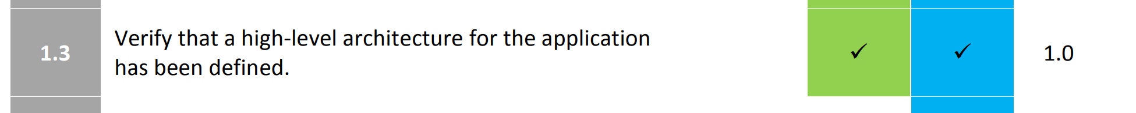
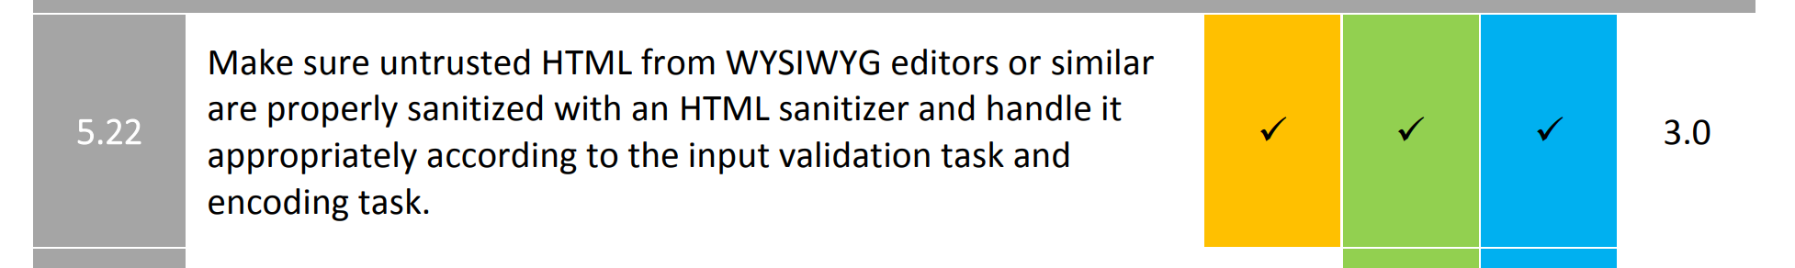
Non-OWASP ASVS security methodology

Slide 24
Product owners / architects & technical testing team
Product Owner / Architect | Security Testing Department
Define security requirements for AUT | Perform security assessment to verify defined requirements
Prepare the software architecture document (SAD), NFR checklist and security risk analysis document. | Verify SAD, NFR and SRA to be compliant with defined security expectations
Identify particular focus areas for code review, and participate follow-up meetings. | Complete security code review to verify source code do not contain vulnerabilities
Ensures that business and project goals are met | Report on deviations from security expectations
Gather results in the form of new or updated standards, guidelines and best practices | Keep up-to-date knowledge on new threads, vulnerabilities trends

Slide 25
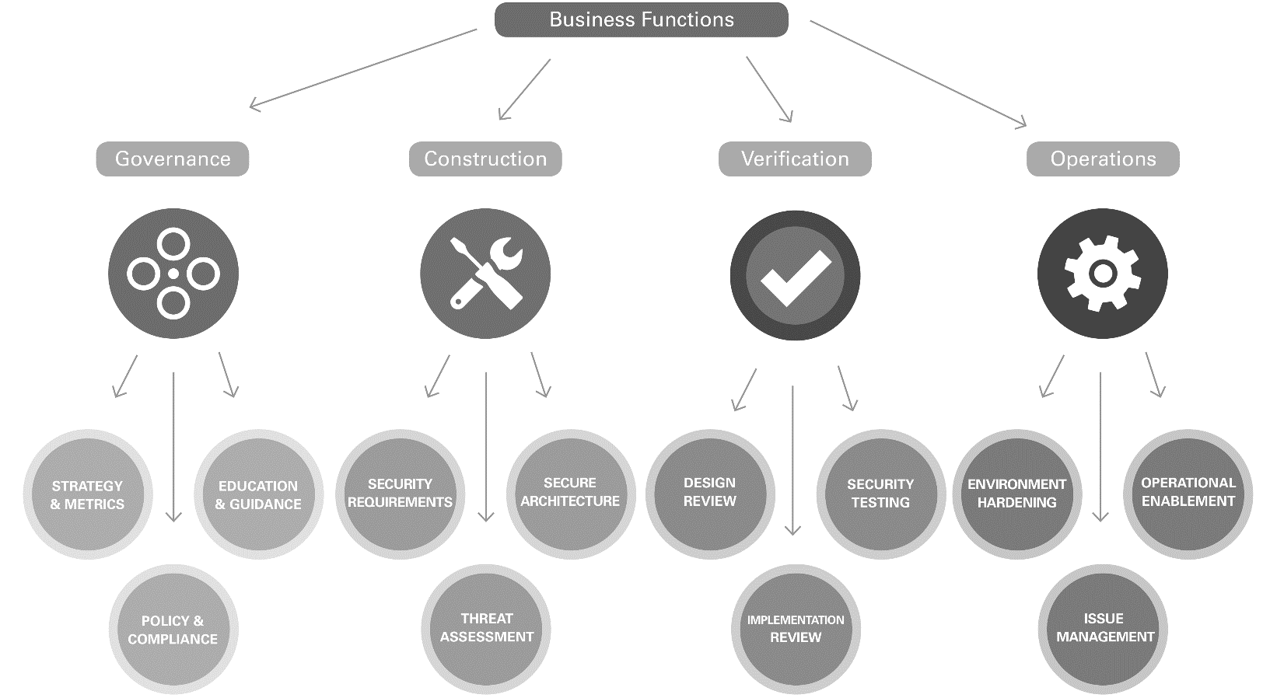
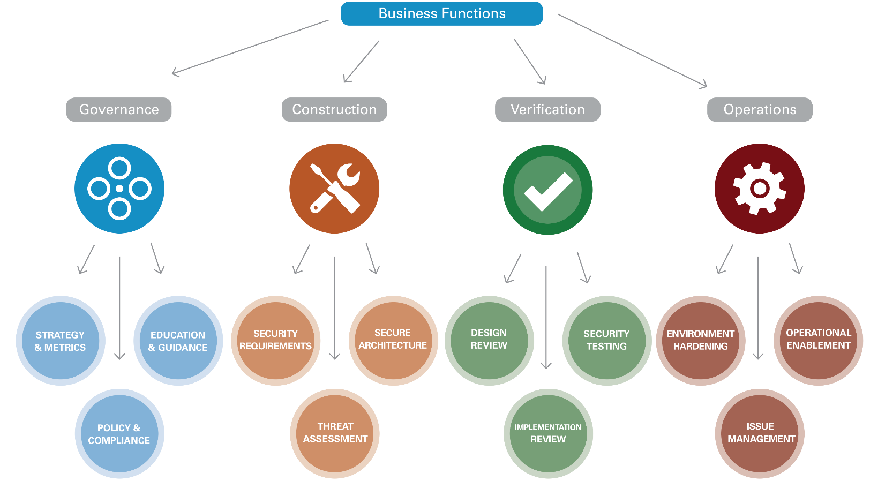
OWASP Software Assurance Maturity Model (SAMM) and ASVS

Slide 26
Applicability
Information Gathering
Vulnerability Analysis
Attack Modeling
Exploitation
Evidence Retention
Scoping
Rules of Engagement
Success Criteria
Sign Off
Cleaning up
Reporting
Remediation Mitigation
Retesting
Pre-Engagement
Engagement
Post-Engagement

Slide 27
Conclusions

Slide 28
S.M.A.R.T. criteria
Is the application secure?
Security Development Lifecycle (SDL)
OWASP ASVS

